Slide 1
Multicut Game
Sheng,Yichao
Alliance Divider
Cut the Enemies, Unite the Allies
APB2026 – 12.08.2025

Slide 2
Game Background

Slide 3
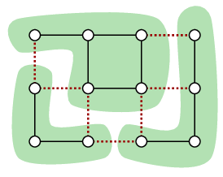
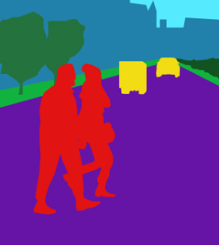
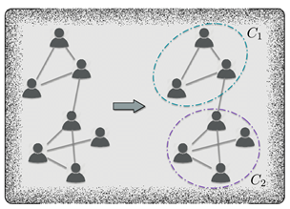
Multicut Problem
Academic Foundation:
Belongs to the family of combinatorial optimization and graph partitioning problems
Key Validity Constraint: No cycle is allowed to be cut by only one edge (Cycle Inequalities)
Known to be NP-hard, commonly solved using ILP for optimal solution
Figure 1: Multicut Example
Source: Swoboda et al. (2017)
Typical Applications:
Image Segmentation: Similar pixels are kept in the same cluster, dissimilar pixels are separated
Social Network Analysis (Community Detection): Friendly relationships are aggregated, conflicting relationships are cut
Figure 2: Image Segmentation Example
Source: Mindy Support
Figure 3: Community Detection Example
Source: Liu et al. (2020)

Slide 4
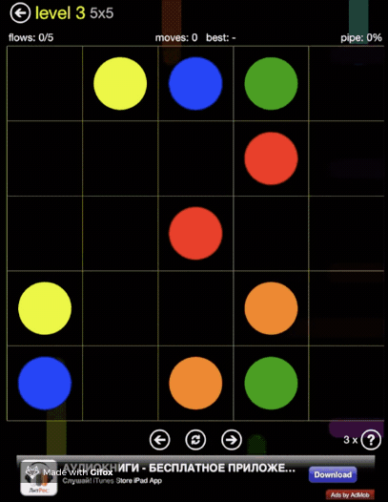
Successful Examples of Academic Gameification
Basic Information:
Release Date: 2012
Over 100 million downloads
Core Mechanics:
Objective: Connect all pairs of dots with the same color
No Intersections: Pipes cannot cross or overlap each other
Algorithmic Foundation:
Graph Theory: Based on graph connectivity problems
Figure 4: Flow Free
Source: lohchness/flow-free-solver (GitHub)

Slide 5
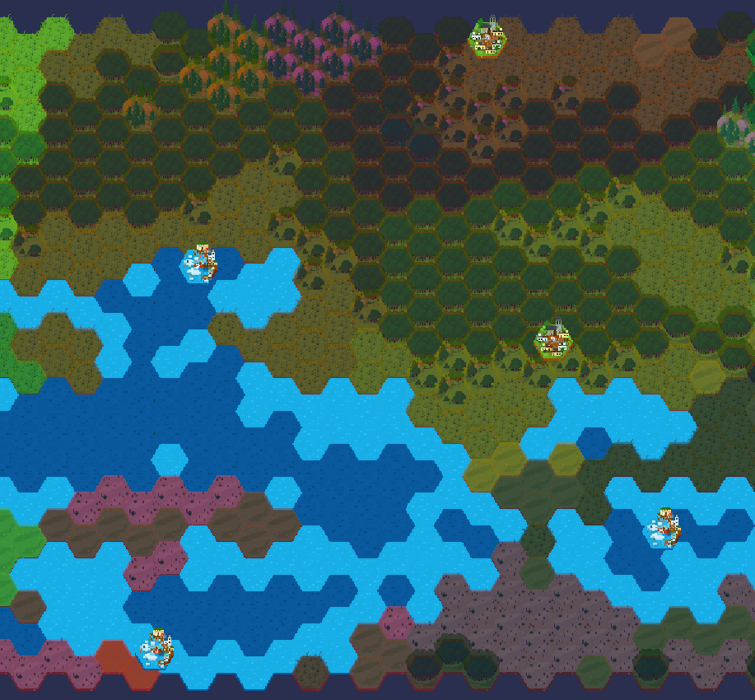
Alliance Divider From "Links" to "Alliances"
Setting:
• Multiple city-states with territories and complex political relationships
• Some relationships are friendly, others hostile
• City-states may form alliances
Player Role:
• Royal Strategist analyzing political networks
• Discover hidden alliance patterns from relationship dynamics
Goal:
• Cut hostile ties, preserve friendly alliances
• Form stable alliance
Figure 5: Game Map

Slide 6
Game HUD

Slide 7
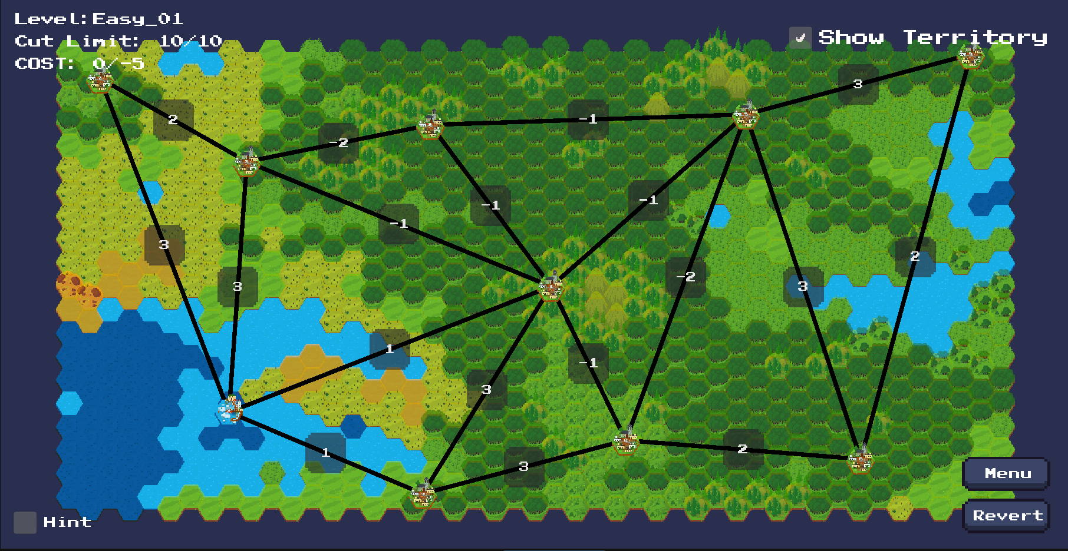
Level Display: Current level information
Level name (Difficulty + levelID)

Slide 8
Cut Limit Display: Remaining cuts available
Available/Total

Slide 9
Cost Display
Current cost / Optimal target cost
Notes:
Smallest cost

Slide 10
How to play
Core Gameplay: From "Links" to "Alliances"

Slide 11
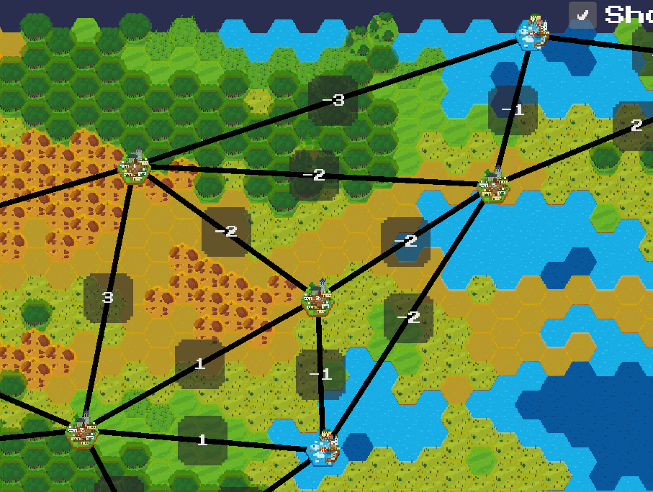
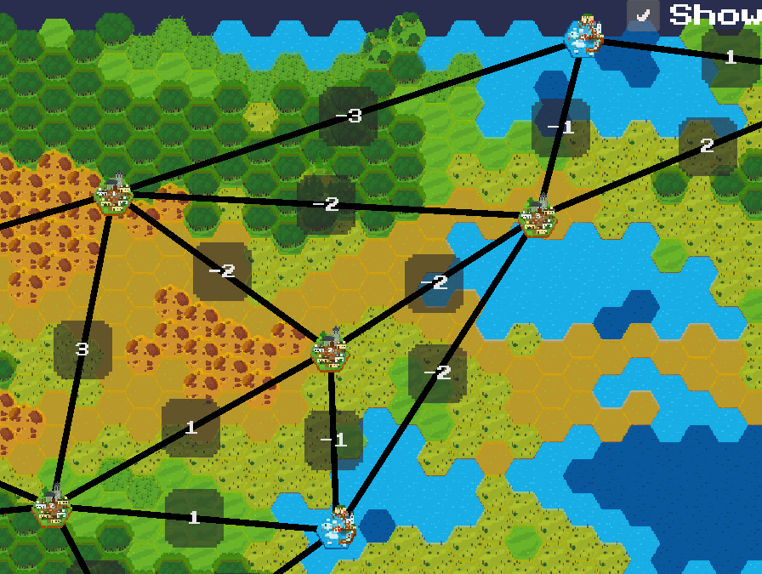
How to play
What is a "Valid Edge"?
An edge that, when cut, splits at least one pair of target vertices into different territories
Why "Low Cost"?
Cutting low-cost edges reduces total consumption and helps meet optimal cost
Step 1：Hold the right mouse button to activate "Cut Mode." Step 2：Choose "Valid & Low-Cost" Edges to Cut Step 3：Observe Results & Optimize Gradually
Invalid Cut
Valid Cut

Slide 12
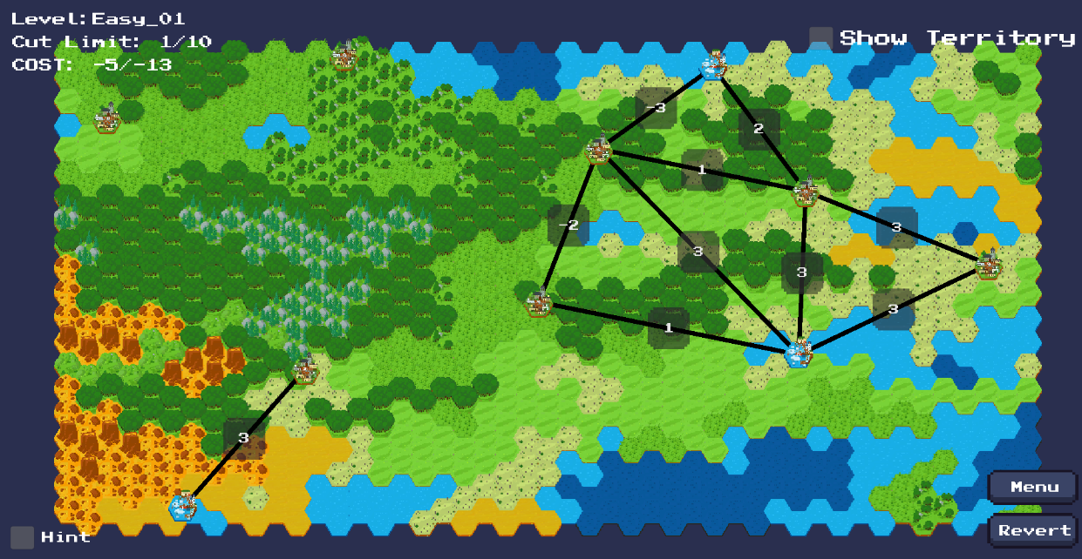
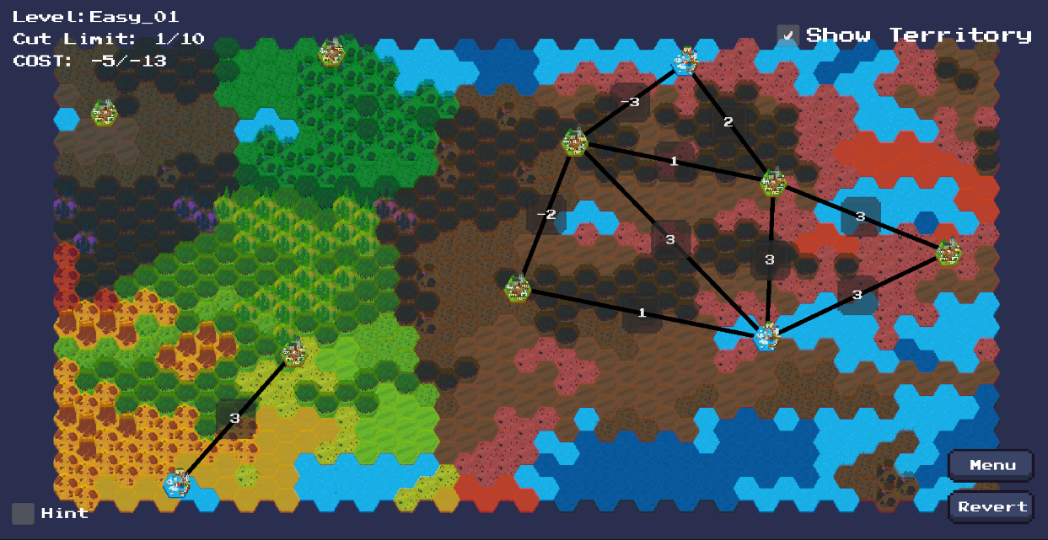
Territory Display: Alliance cluster visualization
Intuitive Display: Help players quickly identify alliance boundaries
Enhance Experience: Materialize abstract graph structures into territories
Color Differentiation: Different alliances use different colors
Association Judgment: Units in same colored area connected by uncut lines

Slide 13
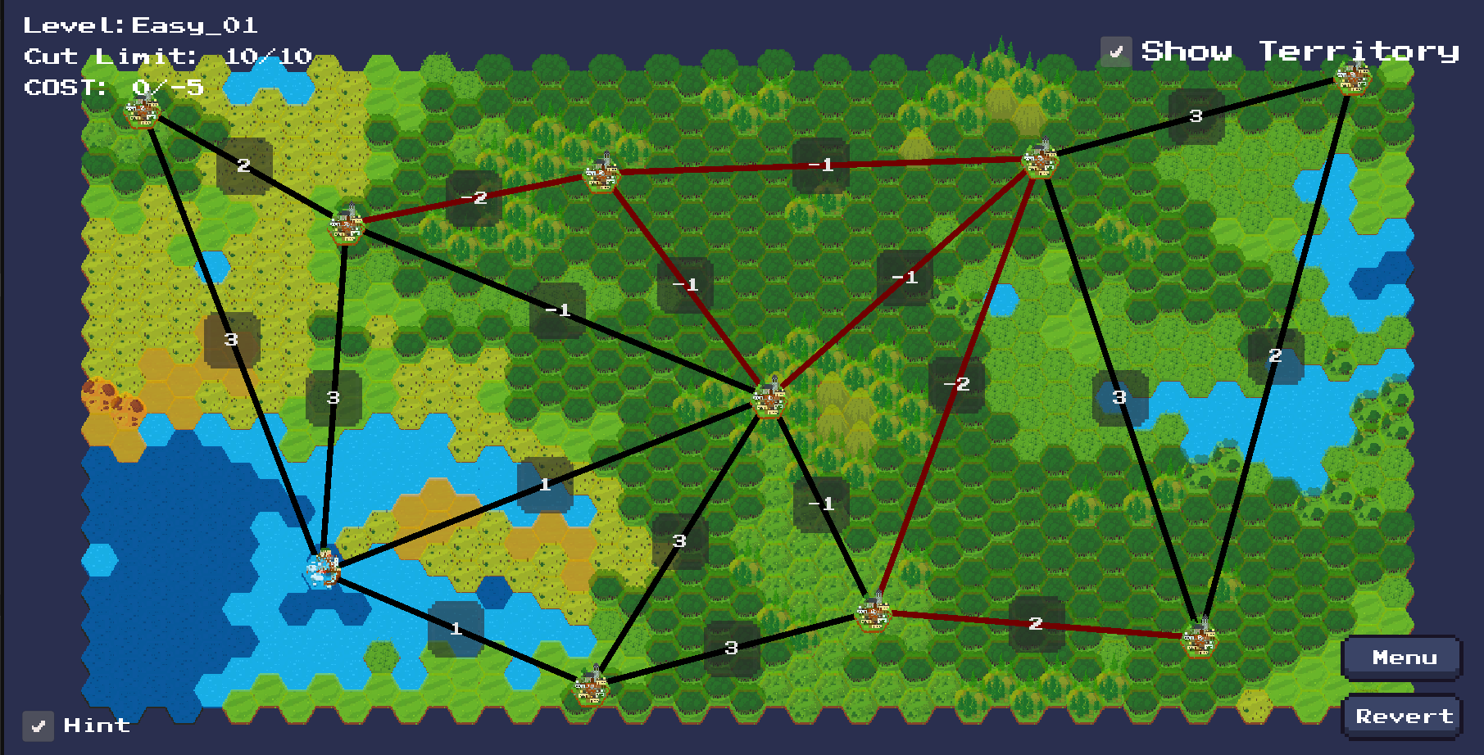
Hint Function: Get optimal solution hints
The optimal cutting solution calculated by the ILP algorithm

Slide 14
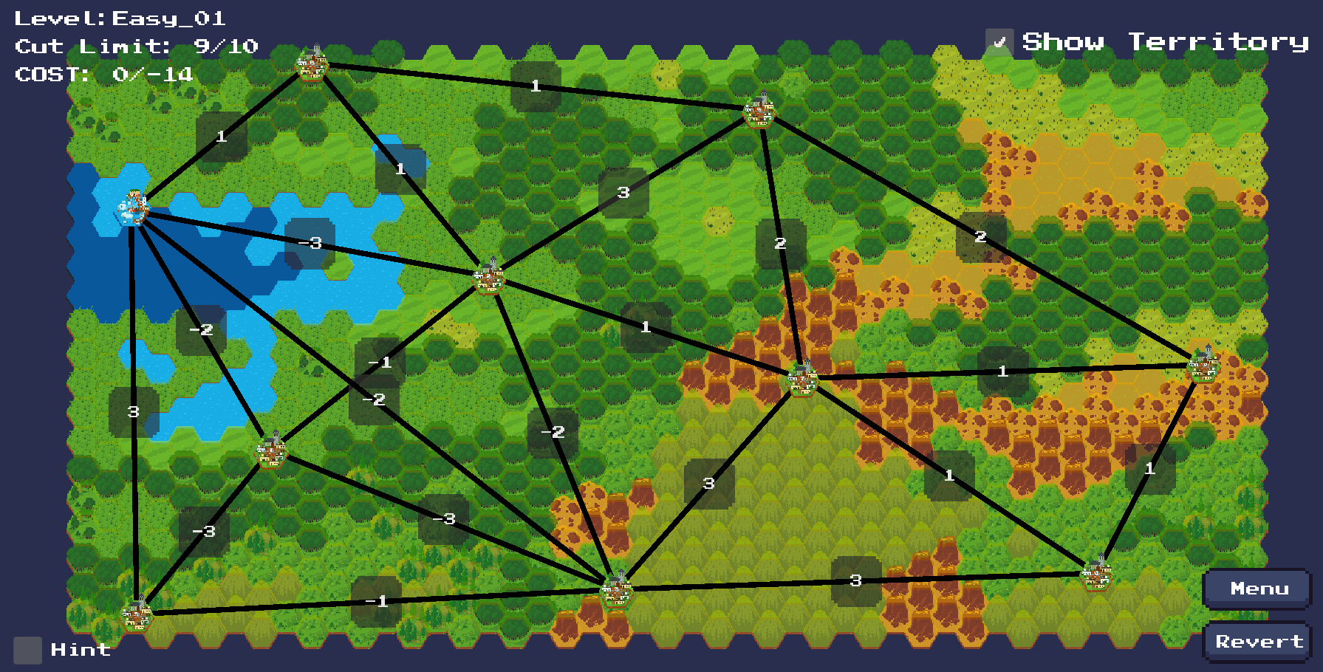
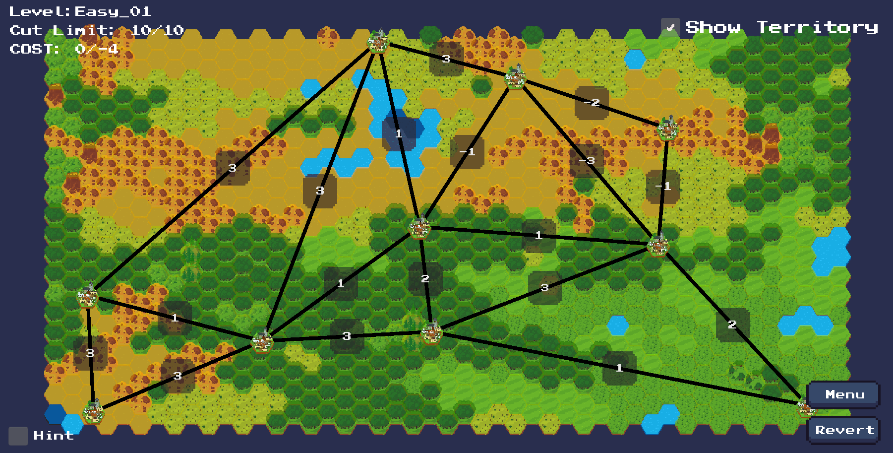
Revert: Undo last action
2 options
Connect again
Click on button

Slide 15
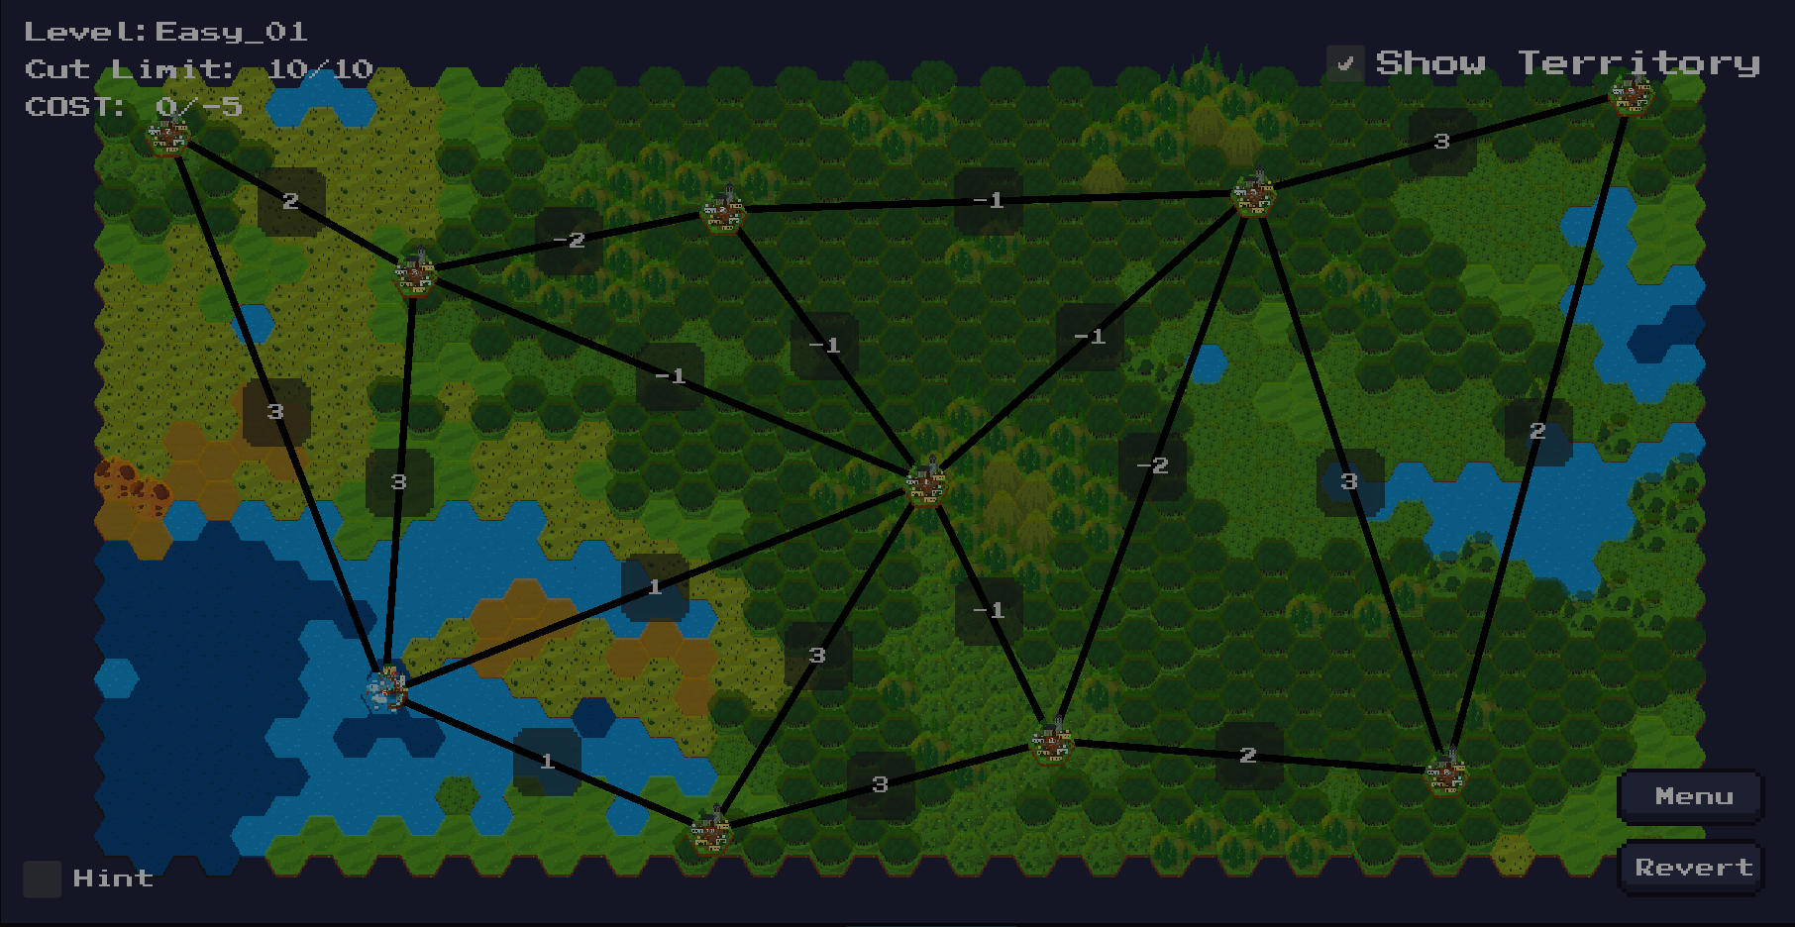
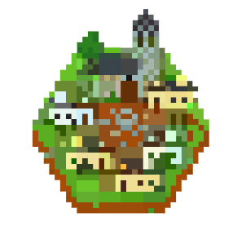

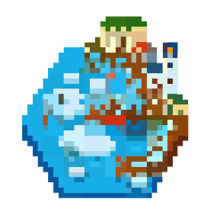

Core Gameplay: From "Links" to "Alliances"
Urban: Spawns on land terrain
Basic units on the map,
divided into two types based on terrain
Port: Only spawns on blue water terrain

Slide 16
Core Gameplay: From "Links" to "Alliances"
Connection strength
Larger values →Tighter connections, higher cutting cost
Smaller values →Looser connections, lower cutting cost
Notes:
Links connecting Urban/Port units, with random numbers representing connection strength:

Slide 17
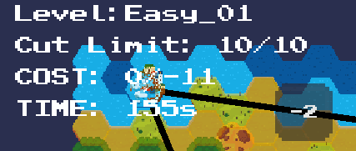
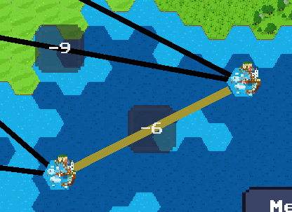
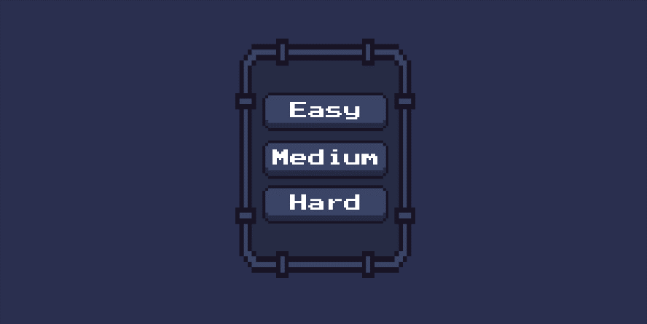
Menu
Press “Menu”
Few city-states(nodes)
More city-states(nodes)
Add timer
Much more city-states(nodes)
Add timer
Add “penalty” edge – cutting will decrease left time
Jump to Menu

Slide 18
Gameplay Demo (Video)

Slide 19
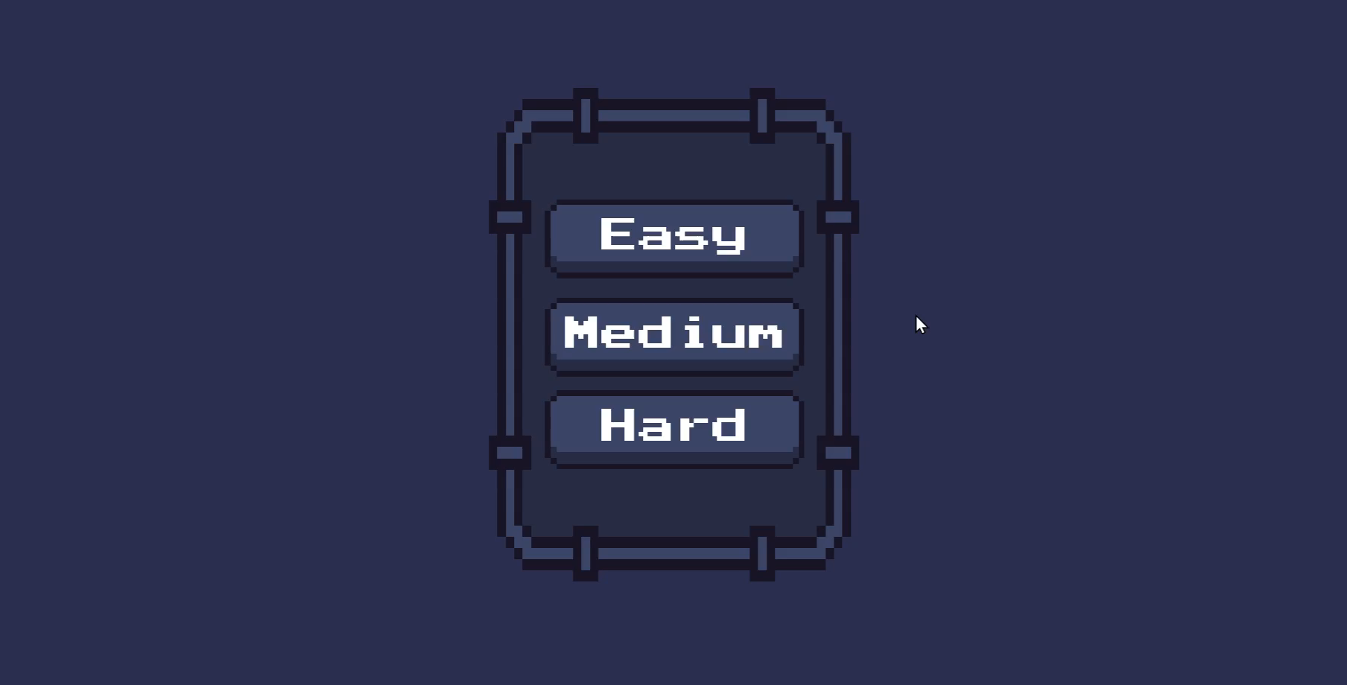

Slide 20
Technical Implementation

Slide 21
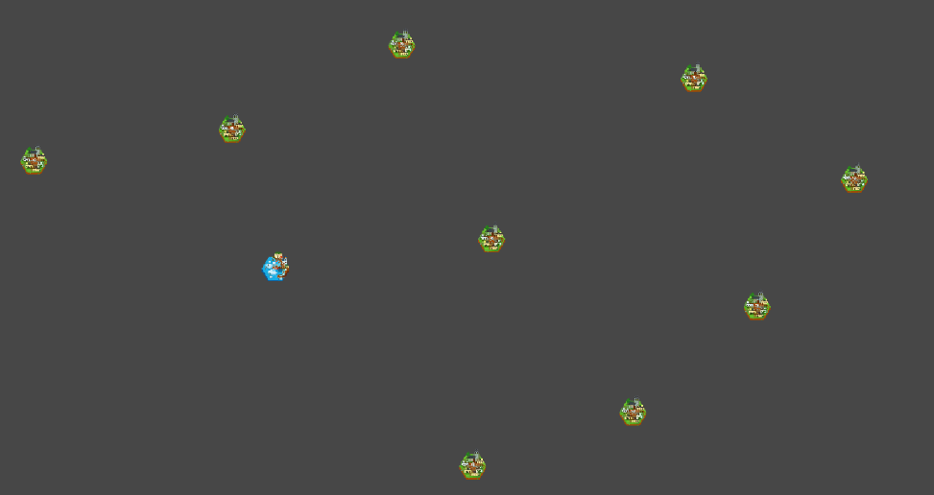
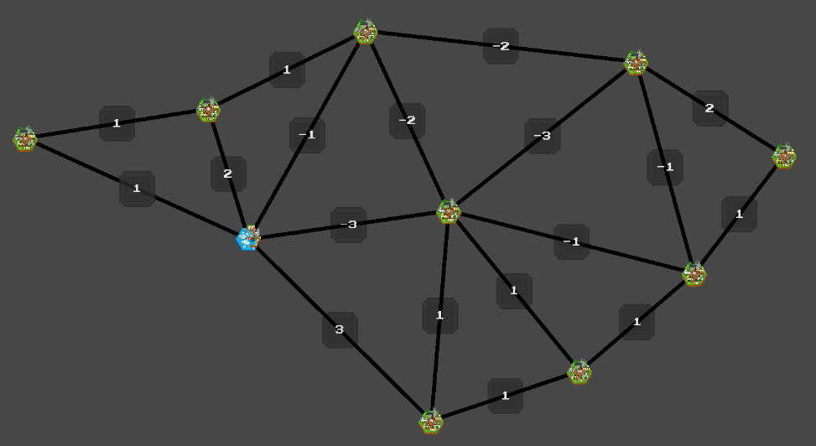
Game Scene Build Generation and Optimization of City-States
1. Generate City-State Positions with Poisson Disk Sampling
Principle: Maintain a minimum distance around each point.
Function: Achieve random distribution while avoiding overlapping, ensuring visual uniformity.
2. Connect City-States via Delaunay Triangulation
Principle: Triangles whose circumcircles contain no other points.
Function: Generate optimal triangular meshes, avoid thin triangles and line segment intersections.
3. Automatic Centering and Scaling for Different Map Sizes
Principle: Calculate the bounding box and normalize it to the screen range.
Function: Automatically adjust position and size to fit various screens.
Figure 6: Poisson Disk Sampling Result
Figure 7: Delaunay Triangulation Result

Slide 22
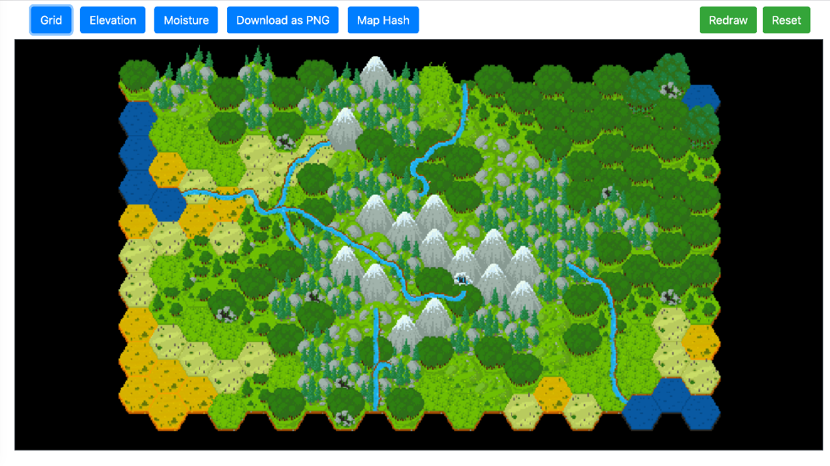
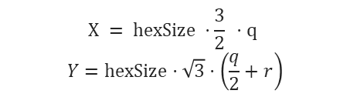
Game Scene Build Third-Party TileMap Generator & Integration
Third-party TileMap Generator Source: https://github.com/HextoryWorld/TiledProceduralHexTerrainGenerator Terrain Generation Steps
Step 1: Generate a random heightmap
Step 2: Overlay multiple layers of details
Step 3: Classify terrain types
Step 4: Add humidity variations
Figure 8: TiledProceduralHexTerrainGenerator
Integration Steps
Step 1: Calculate World Coordinates Tilemap coordinates (q,r) → Unity world coordinates (x,y)
Step 2: Handle Coordinate Offset
the origin of Unity is at the screen center (0,0)
Step 3: Invert Y-axis
(0,0)
q
y
r
$$X = \text{hexSize} ⋅\frac{3}{2} ⋅q$$
$$Y=\text{hexSize}⋅\sqrt{3}⋅\left(\frac{q}{2}+r\right)$$
(0,0)
x
Notes:
Since the origin of Unity is at the screen center (0,0) while the origin of TileMap is at the top-left corner, coordinate offset processing is required to align the two systems.

Slide 23
Solving the Multi-Cut Problem: ILP + Gurobi
Challenge: Multi-cut is NP-hard—exact solutions are computationally expensive.
Solution Type | Limitations | Gurobi ILP Advantages
Heuristic Algorithms (e.g., Genetic/Simulated Annealing) | Fast, but cannot guarantee global optimality | Equally fast (powered by Gurobi’s industrial-grade ILP optimization) + rigorously proves global optimality
Approximation Algorithms | Has performance guarantees , but yields poor results | No approximation; delivers theoretically optimal results
Brute-force Approach | Completely infeasible | Feasible with industrial-grade speed

Slide 24
System Integration Unity → Python Cross-Language Integration
Return Solution
C# Process Class Launches Python Process
JSON File - Exchange Medium
Input: Graph structure, edge weight data
Output: Cut edges, optimal cost
Unity (C#)
Provide data(nodes,edges)
C# Process
Python
Build ILP Model
Create
Start
Call
Return Solution
Gurobi Solver
Find Optimal Solution

Slide 25
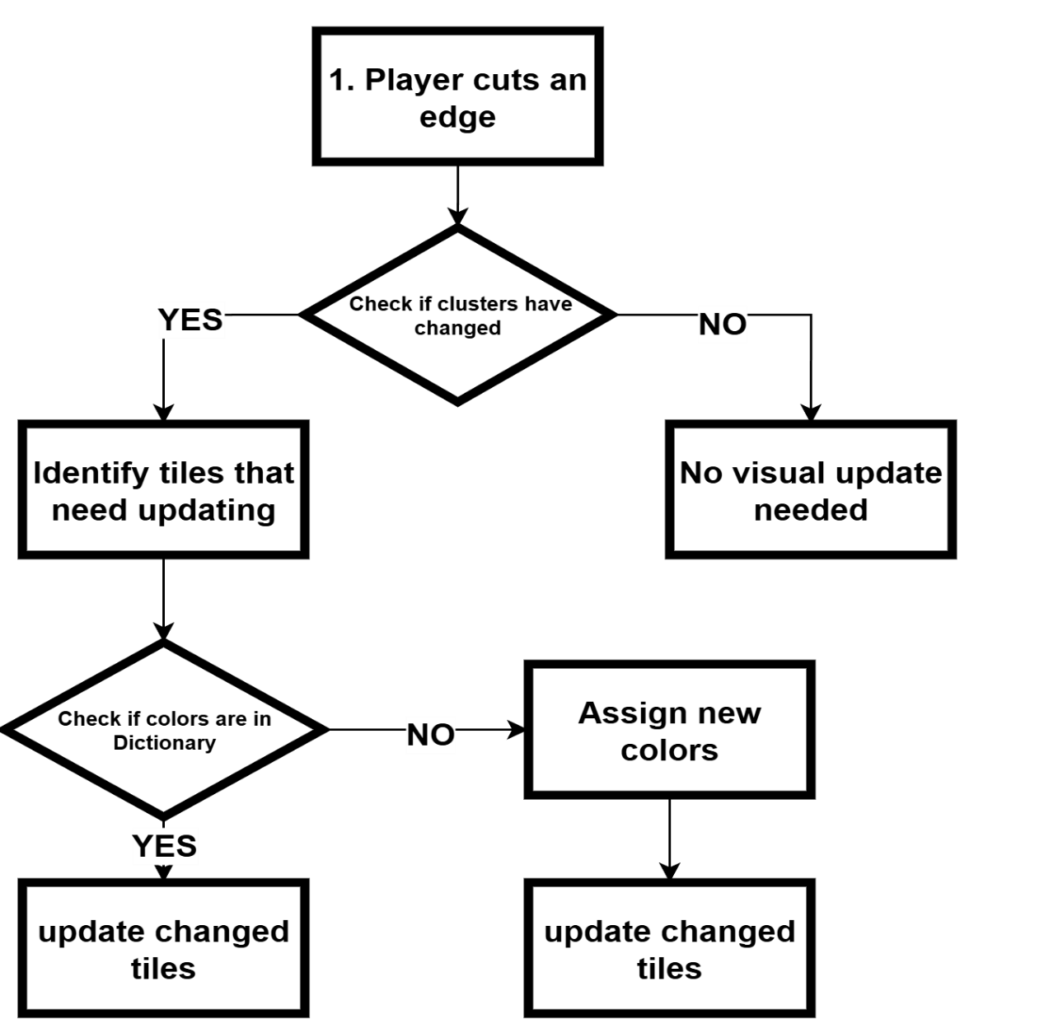
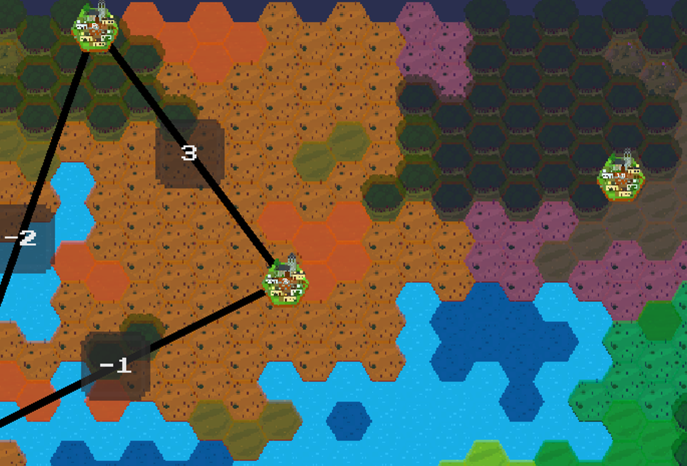
Gamification Design Alliance Territory Coloring
Principle
Based on the Nearest Neighbor Algorithm to allocate terrain tiles to city-states
Function
Establish the correspondence between city-states and terrain
Notes:
"最近邻算法是最直观、最符合直觉的分配方式：
- 玩家期望：地形属于最近的城邦
- 视觉效果：自然的领地边界
- 计算简单：O(n)复杂度，实时性好"

Slide 26
Gamification Design Weight and Difficulty System Architecture
Infinite Level System
Level Change
Node Count
Cut Limit Count
Time Limit Change
Timer
Penalty Edges
Weight Balancing Mechanism
Weight Balancing Mechanism
Smart Flip Algorithm
Levels
Difficulty System
Easy
Medium
Hard

Slide 27
Prospect

Slide 28
Prospect
Optimize territory display performance and resolve lag issues
Add random events to change edge weights
Hostile city-states actively repair cut edges for confrontation
Mountains, rivers, forests modify edge weights

Slide 29
TilemapGenerator

Slide 30
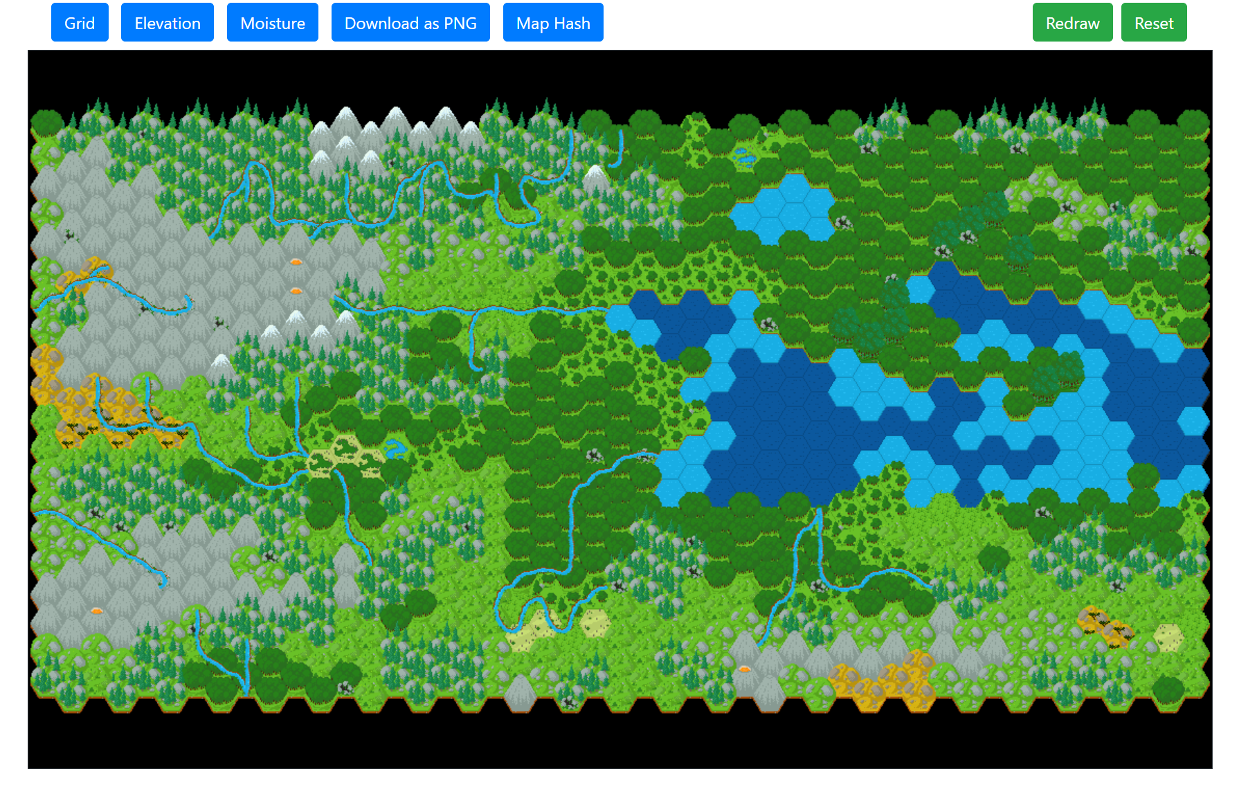
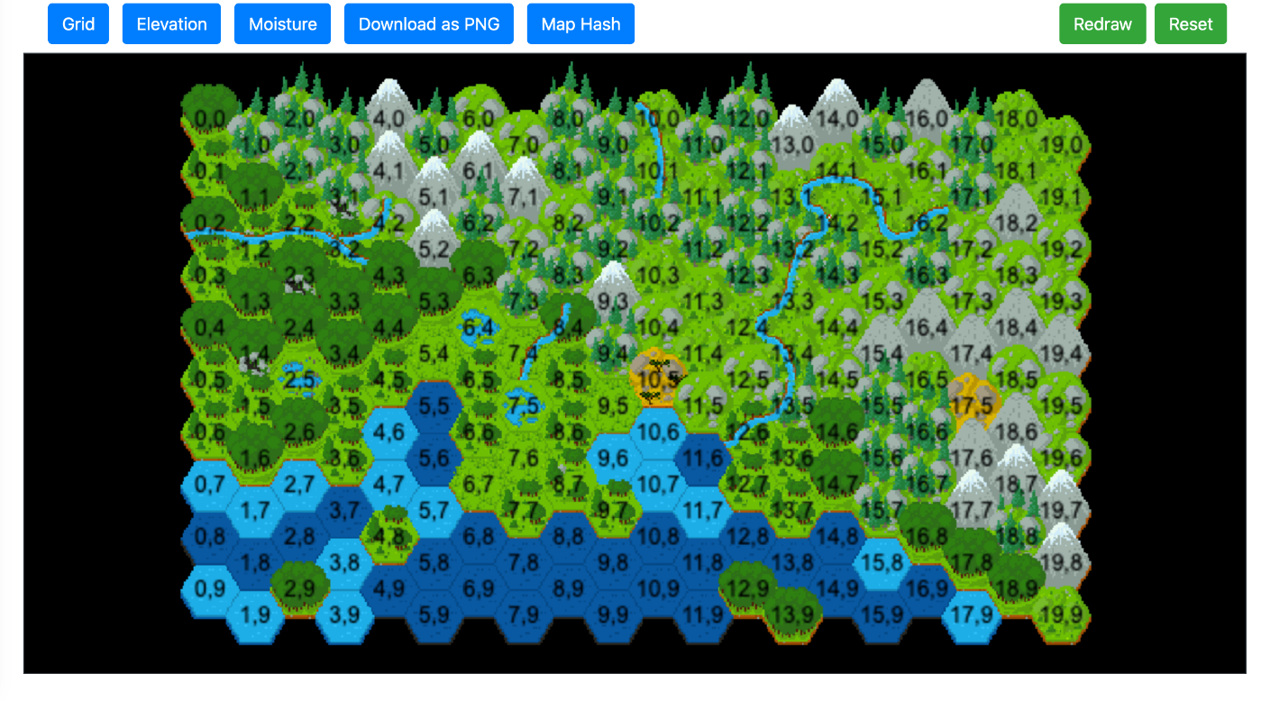

Slide 31
Tilemap系统与普通坐标转换

Slide 32
无效切割阻碍的实现

Slide 33
权重平衡机制
**问题背景**
• 随机权重生成可能导致分布不均
• 三角形内全是负数边的情况
• 最优解为0的无聊局面
• 影响游戏挑战性和可玩性
**平衡策略**
• 负边比例控制：确保35%负权重边
• 最小负边数量：至少3条负权重边
• 智能翻转算法：将最小正权重边变负
• 保守调整：只翻转必要的边数量
**智能翻转算法详解**
• 步骤1：统计当前负边比例和数量
• 步骤2：计算需要翻转的边数量
• 步骤3：收集所有正权重边
• 步骤4：按权重从小到大排序
• 步骤5：优先翻转最小正权重边
• 步骤6：将正权重变为负权重
**效果验证**
• 确保每关都有足够的负权重边
• 保持游戏的挑战性和策略性
• 避免最优解为0的简单局面
• 提升整体游戏体验
**技术亮点**
• 动态权重平衡算法
• 智能边权重翻转策略
• 实时权重分布监控
• 游戏可玩性保障机制

